Slide 1


Marketing and Firm Value
Shuba Srinivasan and Dominique Hanssens
Boston University and UCLA
Marketing Science Institute Webinar
January 31 2023
Notes:
Link to the IJRM paper in the chat

Slide 2

The need for an updated “marketing–finance interface”:The managerial gap
Demonstrating the impact of marketing actions on financial outcomes is #1 C-suite communication challenge (CMO survey 2019-2022)
11% of revenues are in marketing investments, yet only 41.6% are able to quantify its impact
Short tenure of CMOs (3.5 years compared to 7.2 [CEO] or 5.7 [CFO])
Juniorization of the marketing staff (Fournier et al. 2020)
Marketing function is responsible for stock market performance in only 3% of companies (even a decrease since 2014) (CMO survey August 2019)
Marketers do not use stock prices or Tobin’s q to evaluate the effectiveness of marketing-mix activities (Mintz and Currim 2013, JM)

Slide 3





The need for an updated “marketing–finance interface” review article (3):
A new business and marketing landscape
Customer value
Shareholder
value
Employee value
Supplier value
Community value
Shareholder value
“A company cannot achieve long-term profits without embracing purpose and considering the needs of a broad range of stakeholders.”
(Larry Fink, CEO of BlackRock)
Notes:
Translation of fake Coca Cola commercial in Germany during christmas time 2018:
„For a merry christmas time: Say no to AfD!“
Some explanations:
AfD is a right-wing party and currently the largest opposition party in the German parliament
The poster was not put up by Coca-Cola, but by an anti-racist initiative
When Coca-Cola Germany was confronted by AfD, it made the statement: „Not every fake has to be wrong“
Here is a NYT article on that: https://www.nytimes.com/2018/12/11/world/europe/germany-afd-coca-cola.html

Slide 4
Typical Research Questions
How does the stock market react when companies build brands, launch new products and engage in marketing activities that may not yield immediate cash-flow benefits, but strengthen the long-term viability of the enterprise?
Are managers influenced by investor behavior, for example, does the recent evolution of stock prices impact the types of marketing activities the firm engages in through a feedback loop?
These and other questions are of interest to both academic disciplines, but also to their practice communities.

Slide 5
Marketing-Finance Interface
Stock price is a recognized consensus metric of a firm’s economic health and, as such, marketers are well served by knowing which of their actions, if any, either lift or depress stock prices.
In that context, the finance literature on asset pricing relies heavily on the efficient markets’ hypothesis (EMH), which states that all value-relevant information about firms is incorporated immediately and fully in their stock prices.
The EMH comes in three forms: weak efficiency (only historical information on the firm is incorporated), semi-strong efficiency (historical data plus newly emerged public information) and strong efficiency (semi-strong efficiency plus private information).
  Strong efficiency has been ruled out empirically and, in fact, the use of insider (private) information in stock trading is illegal precisely because it can result in substantial capital gains for the information holder.

Slide 6
Marketing-Finance Interface
General consensus in the financial community that market efficiency holds somewhere in between its weak and its semi-strong form.
Herein lies an important connection with the marketing discipline, because marketing almost always involves releasing new and publicly available information.
  In general, favorable developments affecting cash flows would result in increases in stock price, and unfavorable developments would result in decreases (Mizik and Jacobson 2004).
  That is, all else equal, the stock market should reward firms with higher stock prices as “good news” about marketing becomes available. In contrast, “bad news” about marketing should have the opposite effect.
  In other words, stock market valuation should be in sync with product-market valuation—actions that drive value in product markets should also drive firm value.

Slide 7
Journal-based evolution of the marketing-finance interface over time
Chart*
Observations
  General upward trend
Majority in marketing outlets with strong managerial focus (JM, JAMS)
59 studies outside of marketing, with largest share in the foundational field of finance
*The year 2020 was not included in the chart due to partial count (deadline for inclusion: April 30, 2020).
Notes:
Edeling et al. (2021)’s search led to the identification of 285 empirical articles, 226 (or 79.3%) of which were published in or after 2009. Fig. 1, panel A, shows the evolution of the number of publications per year, both overall and journal specific. The authors conclude as follows: (1) taking the year 2009 as a positive outlier due to the Journal of Marketing special issue, there is a general upward trend in published articles; (2) the vast majority of studies have appeared in major journals with a managerial focus (Journal of Marketing and Journal of the Academy of Marketing Science); and (3) the number of studies dealing with marketing-finance topics outside the marketing discipline is considerable, with 59 studies (or 20.7%) in total. Among those, finance has the largest share (28 articles), followed by management/strategy (15) and accounting (14). Thus, while marketing–finance research has been growing rapidly in the marketing discipline, it has also spread (or developed in parallel) to related disciplines, in particular the foundational field of finance, where the focus has been on innovation, advertising, digital metrics, and, particularly, corporate social responsibility (CSR).

Slide 8

Method-based evolution of the marketing-finance interface over time
Chart*
Observations
  Event studies, firm-value level models (mostly Tobin‘s q) and stock return response models with largest use
  Less focus on persistence modeling and portfolio studies
  Trend towards models with other performance outcomes and feedback models
*The year 2020 was not included in the chart due to partial count (deadline for inclusion: April 30, 2020).
Notes:
The different marketing-finance research methodologies, based on the Fama–
French model, have been used with different frequencies (see Figure 1.3):
short-term (90, 19.7%) and long-term (11, 2.4%) event studies, stock
return response models (75, 16.4%), calendar time portfolio models (30,
6.6%), and persistence (VAR) models (16, 3.5%).

Slide 9
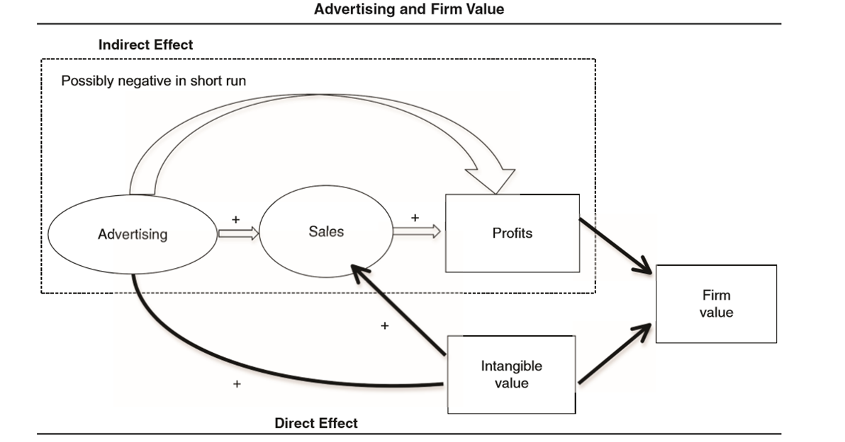
Marketing and Firm Value (Source: Joshi and Hanssens 2010)

Slide 10
Generalizable results – quantitative synthesis
Stock return findings:
Most-often analyzed marketing variables
Identified groups
 | Stock return
Marketing variable (category) | + | 0 | -
Advertising expenditures (actions) | 12 | 8 | 5
Customer satisfaction (assets) | 12 | 9 | 0
New product introductions (actions) | 15 | 5 | 0
CSR (actions) | 3 | 4 | 4
Alliances (configuration) | 12 | 4 | 4
Customer-based brand equity (assets) | 8 | 11 | 0
R&D expenditures (actions) | 1 | 2 | 1
Product quality (assets) | 5 | 5 | 0
Financial brand equity (assets) | 2 | 2 | 0
Product recall (actions) | 1 | 2 | 5
Earned social media volume (assets) | 7 | 2 | 0
Earned social media negative sentiment (assets) | 0 | 1 | 7
Earned social media positive sentiment (assets) | 2 | 1 | 0
Myopic management (actions) | 2 | 1 | 5
Only positive or neutral findings
Mixed positive and negative findings, but predominantly positive
Mixed positive and negative findings, more or less balanced
Strong overweight of negative effects

Slide 11
Brand Equity and Firm Value
Comparing Interbrand’s 111 “World’s Most Valuable Brands” to two benchmark portfolios: strong brands deliver higher monthly stock returns, with lower risk (Madden, Fehle & Fournier 2006).
Comparing Tobin’s q for 113 firms over 5 years: corporate branding > house-of-brands > mixed branding (Rao, Agarwal & Dahlhoff 2004).

Slide 12
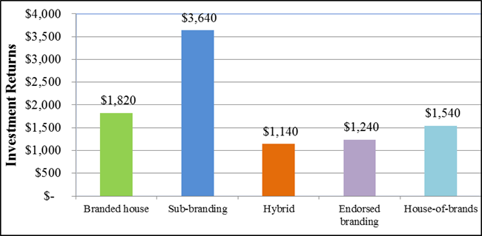
Empirical Results on Returns: Value of $1000 invested (over a 10-year period)

Slide 13
How about Marketing Overall and Firm Value?
 | Firm Value Elasticity
Advertising | .04 | Edeling-Fischer JMR 2016
Brand Assets | .33 | Edeling-Fischer JMR 2016
Customer Relationship Assets | .72 | Edeling-Fischer JMR 2016
Innovation | + | Sood-Tellis MKS 2009
Notes:
In technical terms, customer satisfaction strengthens both brand equity and customer equity.
These two marketing asset metrics, in turn, have a positive impact on firm value, holding constant other determinants of firm value. This relationship was quantified in an empirical generalizations study by Edeling and Fischer (2016).
On the basis of nearly 500 estimates from 83 different scientific studies, the authors derive that the average brand strength → firm value elasticity is 0.33, while the customer relationship → firm value elasticity is 0.72. Thus, marketing actions that strengthen the brand and/or the firm’s customer relationships should be viewed as investments, not merely expenses as they sometimes are.
In comparing these elasticities, it is important to note that brand strength may well contribute to customer relationship strength (Calder 2021). In some sectors where brand associations such as “prestige” are important, one metric (brand) may be a subset of the other (customer relationship), which could explain why the latter commands a higher firm-value elasticity.

Slide 14
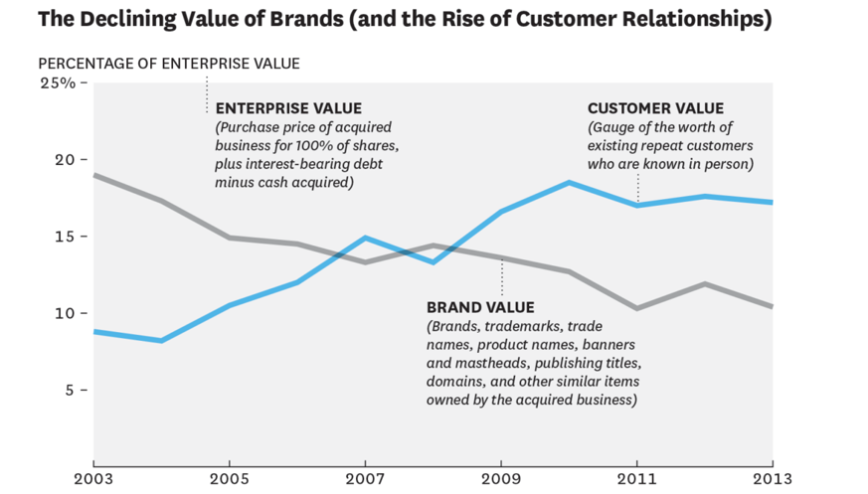
Evolution of brand value vs. customer relations value in mergers & acquisitions
(Source: Binder and Hanssens 2015)
Notes:
The empirical generalizations in Edeling and Fischer (2016) are, by definition, restricted to publicly listed firms.
However, their results were corroborated in a study on the relative importance of brand and customer relationship value for over 5000 mergers and acquisitions between 2003 and 2013 (Binder and Hanssens 2015). These mergers and acquisitions cover both public and private firms and reflect actual prices paid for companies.
The results are shown in Figure 4. They demonstrate the inverse movement of these two metrics over time.
Brand importance declined from about 19 percent of purchase price to around 9 percent, whereas customer relationship value increased from about 8 percent to 17 percent over the same time period.
The authors’ interpretation of these trends is that the recent abundance of high-quality customer data enables companies to maintain stronger customer relationships than in the past. While brand remains an important asset, monitoring and modeling these customer data have become increasingly relevant in customer relationship management and, ultimately, in driving firm value.

Slide 15
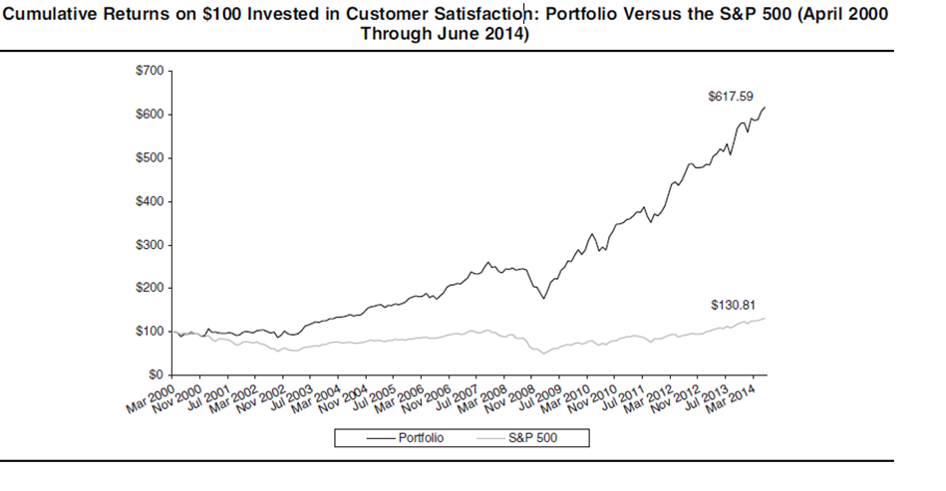
Customer Satisfaction and Firm Value (Source: Fornell et al. 2016)
Notes:
o investors recognize the importance of customer satisfaction? It is often assumed that investors (and, therefore, the stock market overall) react only to changes in firm’s expected future earnings, which sometimes leads to a perception that “only quarterly earnings reports matter.” However, careful empirical research into the determinants of stock prices and stock returns have shown otherwise. For example, Fornell et al. (2016) document that, over a 15-year period (2000-2014), an investment portfolio based on firms’ customer satisfaction scores, would have yielded a cumulative return of 518 percent. By comparison, and as shown in Figure 3, investing in the S&P500 would have yielded a cumulative return of 31 percent over the same time period. Note that this long sample period includes the major financial crisis that started in 2007.

Slide 16
Customer Satisfaction and Firm Value (Source: Fornell et al. 2016)
Key takeaway is that customer satisfaction movements, even though they are not financial metrics, contain information about the future of a business that is not picked up by earnings and other financial data collected at the same time.
The marketing profession offers, of course, an intuitive explanation for this phenomenon:
  satisfied customers are more likely to remain loyal to the brand,
  to increase their consumption of the brand and/or
  to recommend the brand to others,
  all of which impact future revenue generation in ways that current cash flows may not (yet) reflect.

Slide 17
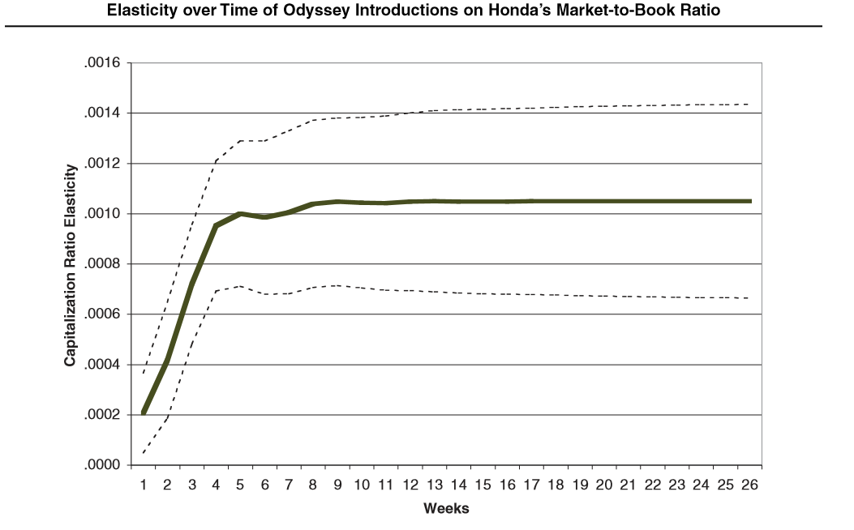
Product Innovation and Firm Value (Source: Pauwels et al. 2004)

Slide 18
Innovation and Growth in the Auto Industry
(Pauwels et al. JM 2004)
% major brands Firm Value Impact |  | SUVS | Minivans | Sedans | Small cars
Rebates | + | 17% | 0% | 20% | 20%
 | - | 83% | 100% | 80% | 80%
Innovation | + | 83% | 83% | 60% | 100%
 | - | 17% | 17% | 40% | 0%
Notes:
How big are results? In hundreds of percentages see Devinney and Winer .25%

Slide 19
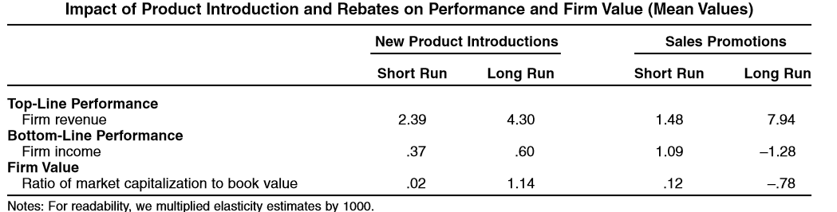
Product Innovation, Sales Promotion and Firm Value (Source: Pauwels et al. 2004)

Slide 20
How about firm value impacting marketing decisions? Feedback effects
  Myopic management has negative stock-market consequences, and firms should aim to introduce organizational structures to reduce its occurrence (Bendig et al. 2018, JM, Kothari et al. 2016, TAR, Mizik 2010, JMR; Srinivasan and Ramani 2019, JM)
  Firms that are (or become) publicly listed alter their innovation behavior substantially (Bernstein 2015, JF; Moorman et al. 2012, MktSci; Wies and Moorman 2015, JMR)
Notes:
Make 4 sldes out of it
Always highlight one
Say that more is in the paper

Slide 21
Summary Findings
Marketing Driver | Overall Result on Firm Value
Brand Equity, Customer Equity, Customer Satisfaction and Market Leadership | Marketing assets have a positive and substantial impact on firm value. Among those, customer relationship strength trumps brand strength and market leadership.
Marketing Actions: product innovation, product quality, advertising, price promotion and distribution | Product innovation generally has a positive effect on firm value. Other marketing actions have a small positive or neutral effect on firm value, except price promotions, which can have a negative impact.
Digital Marketing | Digital marketing provides several new customer-generated metrics that can have positive or negative firm-value effects.
Product recalls & data breaches | With increased information flows, certain problematic external events – such as product recalls and data breaches - can have a pronounced negative impact on firm value. Corporate activism as a reaction to external developments needs to be approached carefully, as it, too, can backfire on investor sentiment.
Employee Satisfaction | When employee satisfaction is viewed as important for generating customer satisfaction, it can have a measurable impact on firm value.
CEO and CMO characteristics | Several CEO and CMO characteristics have been found to influence investor sentiment and therefore firm value.
Feedback Effects | There are several documented cases of stock-prices movements driving changes in marketing managerial decisions. However, these decisions do not necessarily serve the best interest of the firm.
Notes:
The empirical generalizations in Edeling and Fischer (2016) are, by definition, restricted to publicly listed firms. However, their results were corroborated in a study on the relative importance of brand and customer relationship value for over 5000 mergers and acquisitions between 2003 and 2013 (Binder and Hanssens 2015). These mergers and acquisitions cover both public and private firms and reflect actual prices paid for companies. The results are shown in Figure 4. They demonstrate the inverse movement of these two metrics over time. Brand importance declined from about 19 percent of purchase price to around 9 percent, whereas customer relationship value increased from about 8 percent to 17 percent over the same time period. The authors’ interpretation of these trends is that the recent abundance of high-quality customer data enables companies to maintain stronger customer relationships than in the past. While brand remains an important asset, monitoring and modeling these customer data have become increasingly relevant in customer relationship management and, ultimately, in driving firm value.

Slide 22
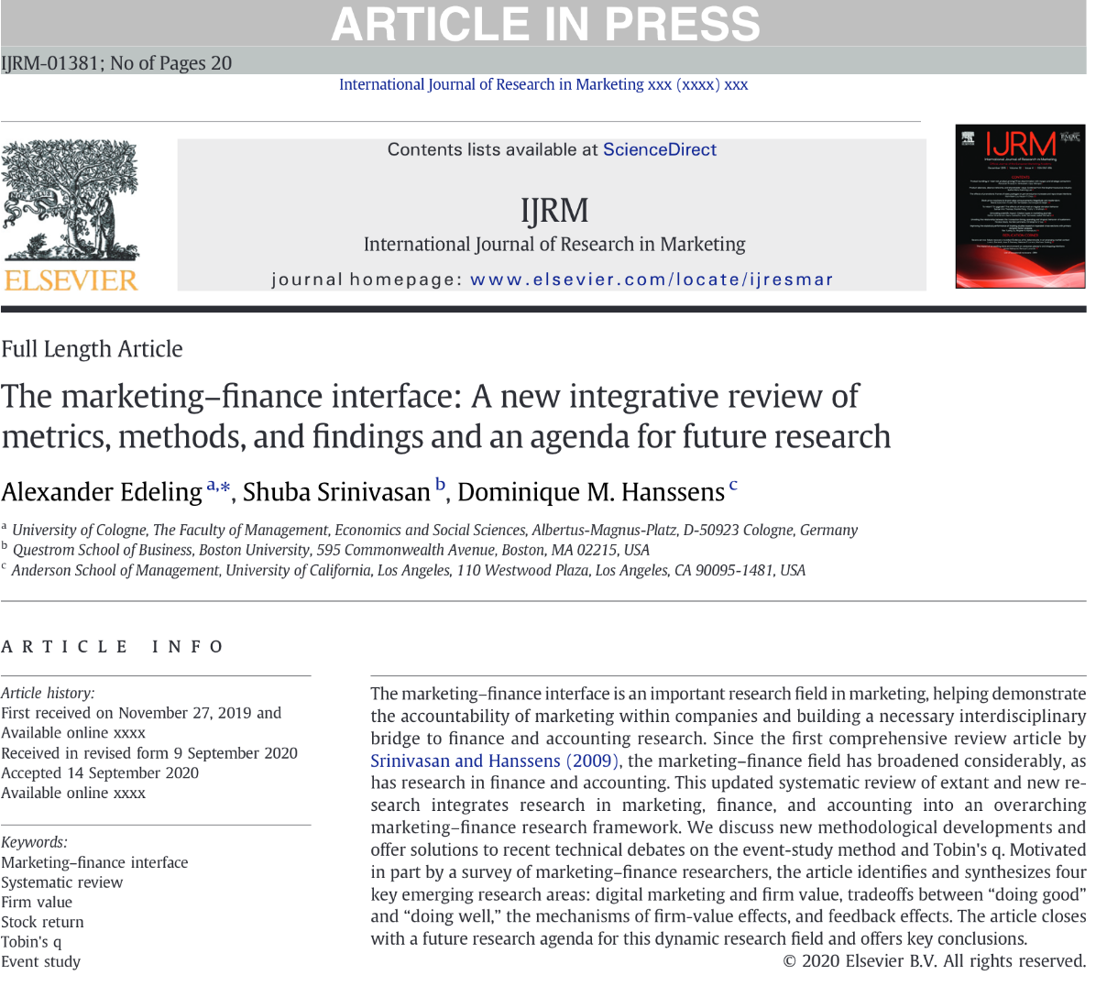

Thank you very much!
ssrini@bu.edu ; dominique.hanssens@anderson.ucla.edu

Slide 23
Back up Slides

Slide 24
RQ 1: Categorization of metrics into marketing-finance framework
Notes:
describes the framework we use to categorize hitherto investigated metrics within the marketing-finance interface.
The classical “4-P” conceptualization from marketing is augmented with customer-asset and brand-asset building actions and activities that involve more than one marketing-mix instrument (e.g., corporate social responsibility activities), leading to the creation of intangible marketing assets. The next step within the chain is the transfer of marketing actions and assets into product market performance (e.g., sales and market share) and accounting performance (e.g., revenues and profits). The “investor community” consists of two groups. , analysts professionally evaluate the future potential of firms in terms of their stock market performance and investors (both individual and institutional) who observe firms’ behavior and performance along the different stages of the value chain. They and react with buy, hold, and sell recommendations (analysts) or buy, hold, and sell decisions (investors). These financial-market participants’ reactions culminate in financial-market performance metrics, which can be subsumed under the term firm value.
This section is inspired by Edeling, Srinivasan and Hanssens (2021).
In Figure 2, we adopt the view of Moorman and Day (2016) that marketing organization is the strategic foundation for the functioning of the conversion of marketing actions into firm value along the marketing-finance value chain. Their view of the marketing organization is operationalized along four dimensions: capabilities (“complex bundles of firm-level skills and knowledge and firm adaptation to marketplace changes”), configuration (“organizational structures, metrics, and incentives/control systems that shape marketing activities”), human capital (“marketing leaders and employees […] that create, implement, and evaluate a firm’s strategy”), and culture (“values, norms, and behaviors that facilitate a focus on the market over time”) (Moorman and Day [2016], p. 6).
Figure 2 also indicates the frequency with which marketing-finance researchers have investigated relationships between marketing variables and financial-market metrics – the numbers in parentheses show the number of studies that have dealt with a category or variable. A majority of studies have investigated either marketing-action (180 studies) or marketing-asset relationships (117). Specifically, the most investigated marketing variables are advertising (39), customer satisfaction (33), new product introductions (25), alliances (17), R&D expenditures (16), customer-based brand equity (15), and CSR activities (10). Figure 2 also highlights the marketing subcategories in which competitor effects have been investigated using the superscript ^{comp}. Examples of such studies include understanding competitor effects on topics such as innovations, promotions, and adverting (Srinivasan et al. 2009), customer data breaches (Martin, Borah, and Palmatier 2017), negative online chatter about product recalls (Borah and Tellis 2016), and celebrity endorsements (Knittel and Stango 2014). Marketing organization is an emerging area of research within the marketing-finance, the most frequently studied topics are configurational themes (38), followed by human capital (17), capabilities (14), and culture (3).
As for the financial metrics, studies with financial-market performance (334) outnumber those that focus on the behavior of financial-market participants (51). Specifically, the most frequently investigated metrics are stock return (167), Tobin’s q / market-to-book ratio (61), idiosyncratic risk (29), systematic risk (25), market capitalization (12), cash flow (10), and total stock risk (6).

Slide 25

Generalizable results
Digital marketing and firm value
  Finding 1: Online communication actions by firms have a positive effect on firm value (Bayer et al. 2020, IJRM; Boyd et al. 2019, JM, Cao et al. 2018, JR)
  Finding 2: Owned social media is a driver of firm value, with potential asymmetries for positive and negative sentiment and likely spillovers on rivals (Bartov et al. 2018, TAR; Borah and Tellis 2016, JMR; Colicev et al. 2018, JM; Huang 2018, JFE, Luo et al. 2013, ISR; Tirunillai and Tellis 2012, MktSci)
  Finding 3: Data breaches can have severe negative firm-value effects on focal firms and, to a lesser degree, rival firms (Kashmiri et al. 2017, JAMS; Martin and Murphy 2017, JAMS; Martin et al. 2017, JM)
Notes:
Make 4 sldes out of it
Always highlight one
Say that more is in the paper

Slide 26

Generalizable results
Tradeoff between doing good and doing well
  Finding 4: In general, positive changes for the customer stakeholder group in terms of higher customer satisfaction are associated with positive shareholder effects (Colicev et al. 2018, JM, Fornell et al. 2016, JM, Larivière et al. 2016, JMR)
  Finding 5: Preliminary evidence suggests that employee satisfaction has a positive effect on firm value and a positive interaction with a firm’s brand and customer activities (Edmans 2011, JFE, Green et al. 2019, JFE, Vomberg et al. 2015, SMJ)
  Finding 6: Evidence of the shareholder-value effect of investing in CSR is highly mixed and contingent on a firm’s marketing and corporate social irresponsibility (CSI) activities, as well as other firms’ CSR behavior in the value chain (Dai et al. 2020, JFE, Kang et al. 2016, JM; Manchiraju and Rajgopal 2017, JAR; Servaes and Tamajo 2013, ManSci; Woodroof et al. 2019, JAMS)
Notes:
Make 4 sldes out of it
Always highlight one
Say that more is in the paper

